Slide 1
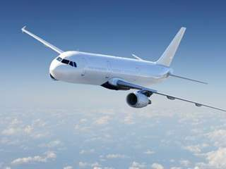

Airline passenger satisfaction
By
Eng. Musa Ghazwani
Abdulaziz Abuhaimed

Slide 2
Introduction
Obtained about 129880 of flight satisfaction surveys from Kaggle.
Goal: Identify critical factors that ensure satisfaction.
Find out the best model for the data through Regularization.

Slide 3
2. EDA and Feature Selection
Target
 | Satisfaction | Gender | Customer Type | Age | Type Of Travel | Class | Flight Distance | Inflight Wifi Service | Departure/ Arrival Time Convenience | Ease Of Online Booking | Gate Location | Food And Drink | Online Boarding | Seat Comfort | Inflight Entertainment | On-board Service | Leg Room | Baggage Handling | Checkin Service | Inflight Service | Cleanliness | Total Delay
0 | Neutral/ Dissatisfied | Male | Returning Customer | 13 | Personal Travel | Economy | 460 | 3 | 4 | 3 | 1 | 5 | 3 | 5 | 5 | 4 | 3 | 4 | 4 | 5 | 5 | 43.0
1 | Neutral/ Dissatisfied | Male | First-time Customer | 25 | Business travel | Business | 235 | 3 | 2 | 3 | 3 | 1 | 3 | 1 | 1 | 1 | 5 | 3 | 1 | 4 | 1 | 7.0
2 | Neutral/ Dissatisfied | Female | Returning Customer | 25 | Business travel | Business | 562 | 2 | 5 | 5 | 5 | 2 | 2 | 2 | 2 | 2 | 5 | 3 | 1 | 4 | 2 | 20.0
3 | Satisfied | Male | Returning Customer | 61 | Business travel | Business | 214 | 3 | 3 | 3 | 3 | 4 | 5 | 5 | 3 | 3 | 4 | 4 | 3 | 3 | 3 | 0.0
4 | Neutral/ Dissatisfied | Female | Returning Customer | 26 | Personal Travel | Economy | 1180 | 3 | 4 | 2 | 1 | 1 | 2 | 1 | 1 | 3 | 4 | 4 | 4 | 4 | 1 | 0.0
... | ... | ... | ... | ... | ... | ... | ... | ... | ... | ... | ... | ... | ... | ... | ... | ... | ... | ... | ... | ... | ... | ...
69061 | Neutral/ Dissatisfied | Female | First-time Customer | 36 | Business travel | Economy | 432 | 1 | 5 | 1 | 3 | 4 | 1 | 4 | 4 | 5 | 2 | 5 | 2 | 3 | 4 | 0.0
69062 | Neutral/ Dissatisfied | Male | First-time Customer | 34 | Business travel | Business | 526 | 3 | 3 | 3 | 1 | 4 | 3 | 4 | 4 | 3 | 2 | 4 | 4 | 5 | 4 | 0.0
69063 | Neutral/ Dissatisfied | Female | Returning Customer | 17 | Personal Travel | Economy | 828 | 2 | 5 | 1 | 5 | 2 | 1 | 2 | 2 | 4 | 3 | 4 | 5 | 4 | 2 | 0.0
69064 | Satisfied | Male | Returning Customer | 14 | Business travel | Business | 1127 | 3 | 3 | 3 | 3 | 4 | 4 | 4 | 4 | 3 | 2 | 5 | 4 | 5 | 4 | 0.0
69065 | Neutral/ Dissatisfied | Female | Returning Customer | 42 | Personal Travel | Economy | 264 | 2 | 5 | 2 | 5 | 4 | 2 | 2 | 1 | 1 | 2 | 1 | 1 | 1 | 1 | 0.0

Slide 4
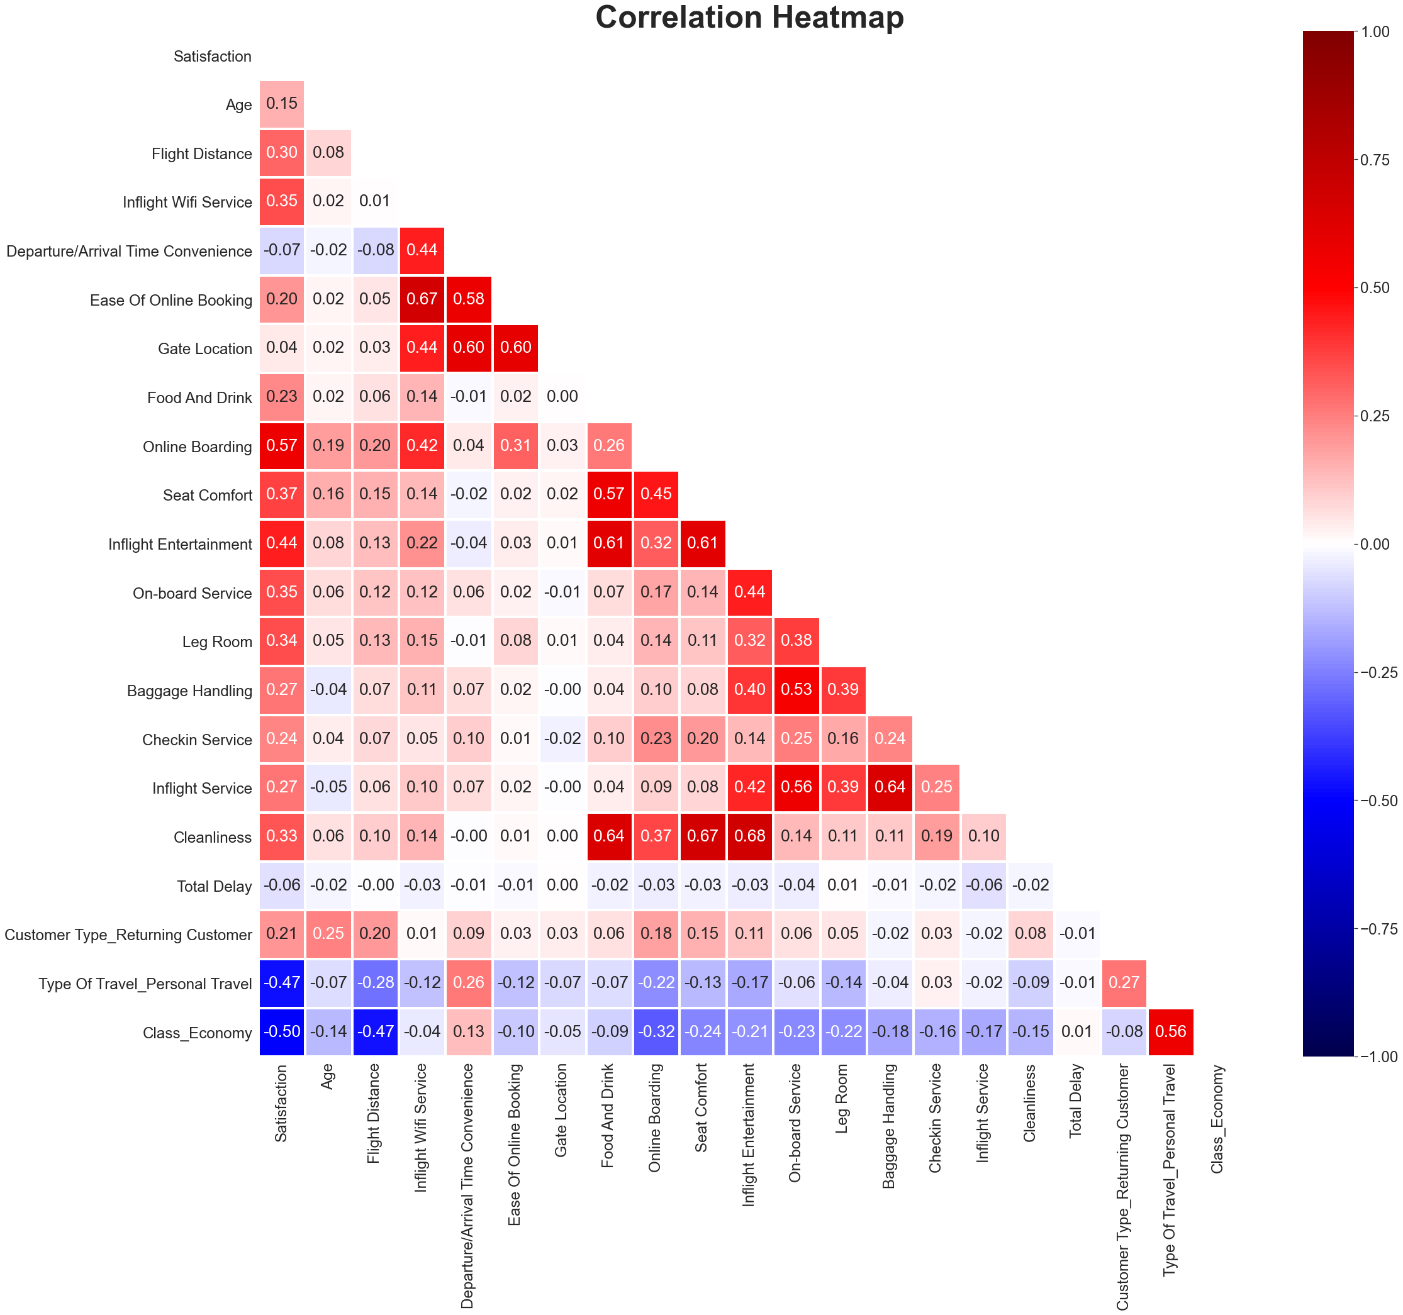
Final Feature Selection
Features to drop:
Gender
Age
Gate Location
Total Delay
Flight Distance
Departure/Arrival Time Convenience

Slide 5
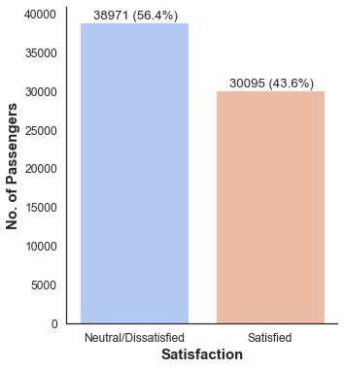
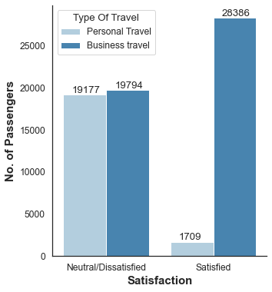
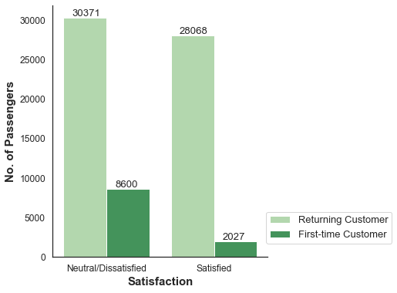
EDA and Feature Selection
The target classes are rather balanced with 56.4% of passengers reporting Neutral/Dissatisfied
(negative class: 0) and 43.6% reporting Satisfied (positive class 1)
segment the satisfaction classes by customer types, we see that first-time customers have a lower
ratio of satisfaction
segment the satisfaction classes by customer types, we see that first-time customers have a lower
ratio of satisfaction.

Slide 6
Model Selection
- k-Nearest Neighbors KNN:
- Logistic Regression Lr:
- Decision Trees:
- Random Forest:
- Ensemble :

Slide 7
Model Selection
Training Set (5-Fold CV)
Test Set
16% | 16% | 16% | 16% | 16% | 20%

Slide 8
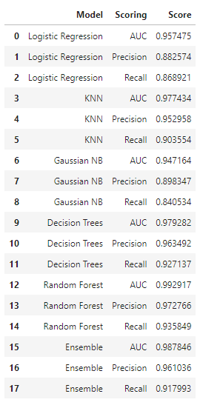
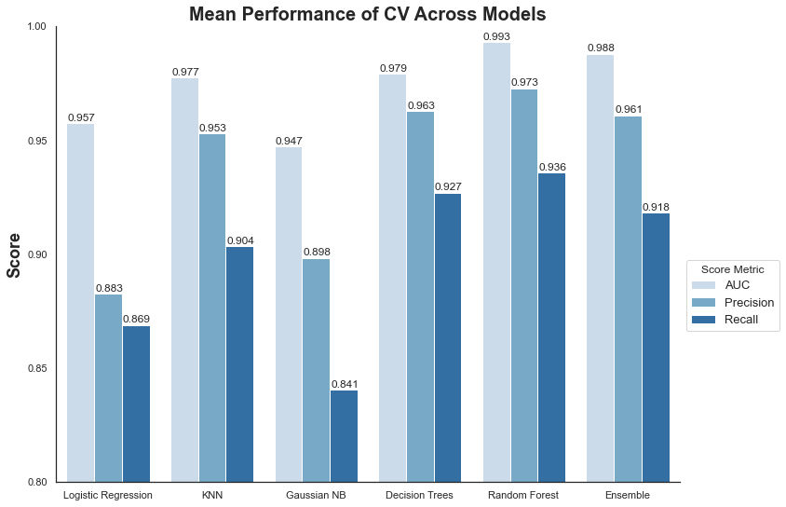
Model Selection

Slide 9
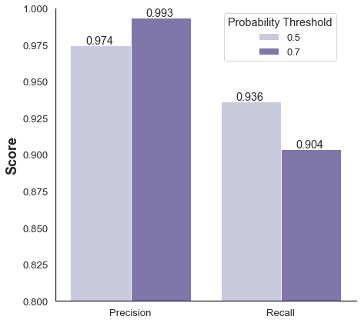
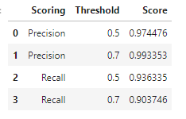
Random Forest
Training Set
Validation Set
Test Set
60% | 20% | 20%
Increase threshold from 0.5 to 0.7
Precision increase from 97% to 99%
Precision-Recall trade-off from adjustment of the probability threshold.

Slide 10
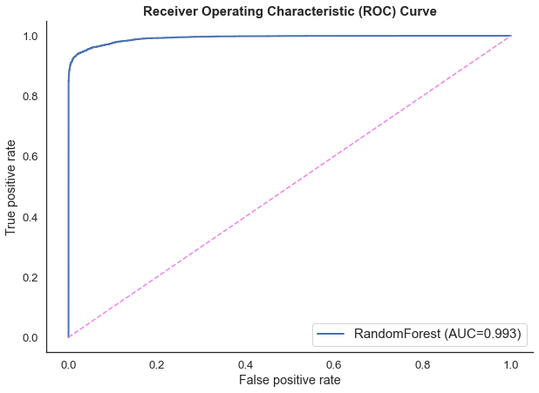
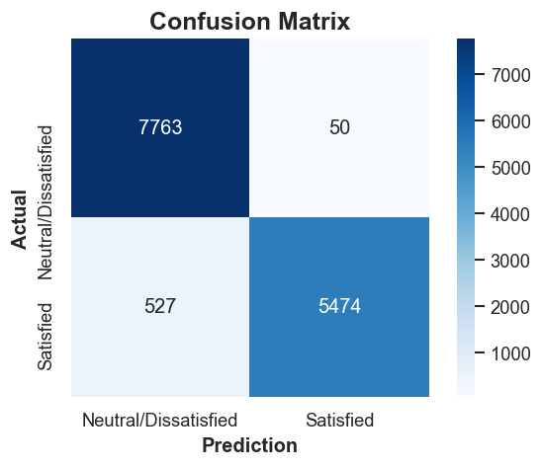
Model Evaluation – Test Set
The final evaluation of model performance gives a AUC of 0.993, Recall of 91.2% and Precision of 99.1%.

Slide 11
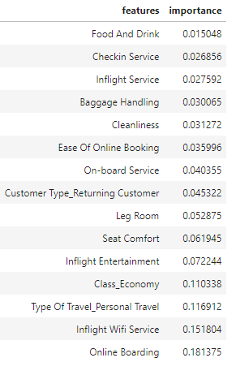
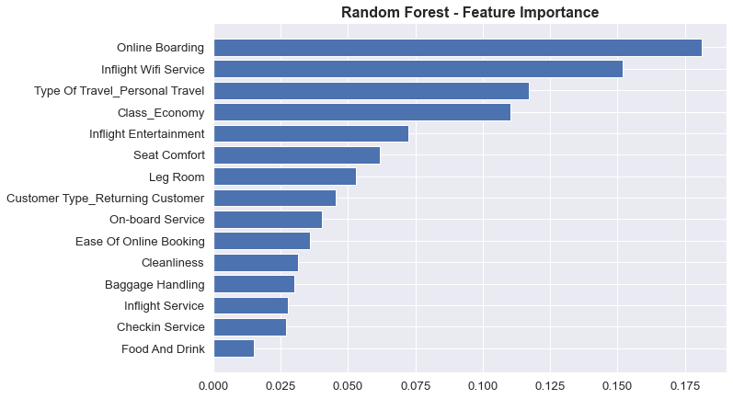
Feature Importance

Slide 12
Conclusion
Airlines should highly focus on inflight wi-fi experience.
Ease of online booking is important for business customers.

Slide 13
Thank You!

